Slide 1
CYBR 405: Steam Compare
Zach Madison, Alex Peters

Slide 2
Chosen API: Steam
This API allows access to information regarding games hosted on the Steam platform, as well as accessing information regarding player accounts on steam
Using this we wanted to create a website that accesses information about two players and their games to compare achievements and playtime between them
API format:
  api.steampowered.com/
    Section of API (user, user stats, player service, etc.)
      Specific fetch command
        Arguments

Slide 3
Steam API: Used Endpoints
Endpoint used from this API include:
  IPlayerService/GetOwnedGames
    Returns a user’s library with hours spent in each game
  ISteamUser/GetPlayerSummaries
    Returns a user’s username and account icon
  ISteamUserStats/GetPlayerAchievements
    Returns a list of achievements with api names and achievement completion (0 for uncompleted, 1 for completed)
  ISteamUserStats/GetSchemaForGame
    Returns a list of achievement api names, display names, and achievement icons
  appdetails
    Different API, returns Steam store info about a game, we use the game icon
    Located at store.steampowered.com/api

Slide 4
General Design
For our design we wanted to try to emulate Steam’s simple design
In order to imitate this, we:
  Imitated the simple color scheme, limiting to dark grey and blue colors.
  Imitated the same two-part design, with a simple head body design.
When designing the program, we wanted to implement a two-state system.
  After the user gives input, instead of changing pages it will make the first div invisible and populate a second div with information pulled from API endpoints

Slide 5
Comparison Design
We wanted to focus information the user would want to compare the most.
  These would be hours spent in game, and achievements obtained.
To convey information, we used a large amount of accordion boxes
  Because some games have a very large number of achievements, this was the most effective way for convenient searching
Other information to convey
  Game name: Adds necessary context for user
  Game Icon: Makes website look better, and if game name is missing the icon will then be able to convey what game the achievements are for.

Slide 6
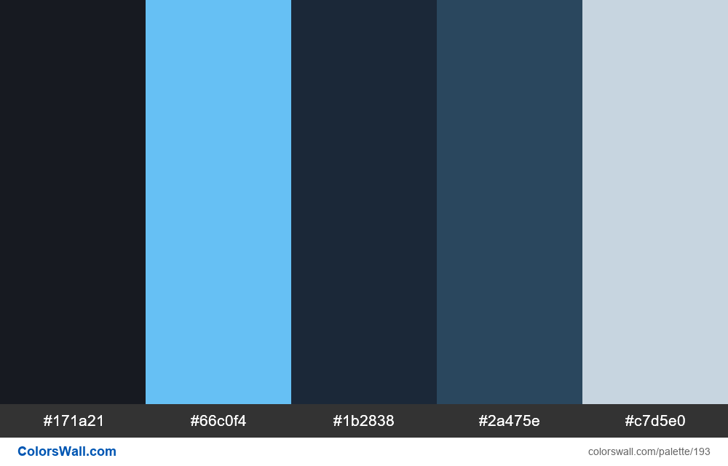
Color Design Document

Slide 7
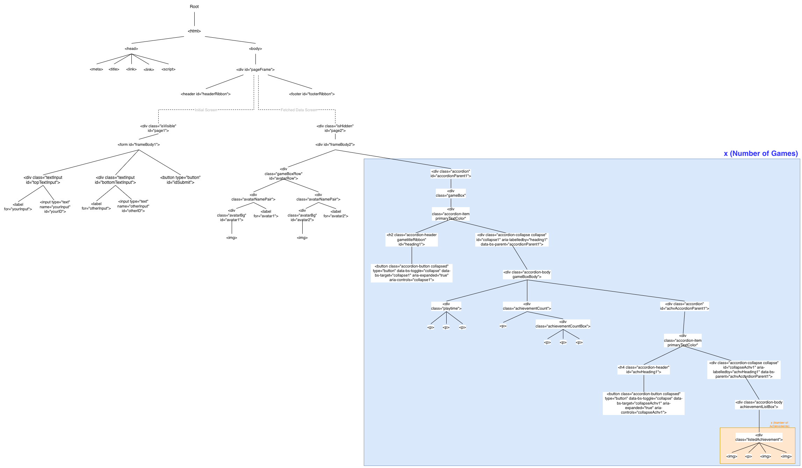
DOM html Diagram

Slide 8
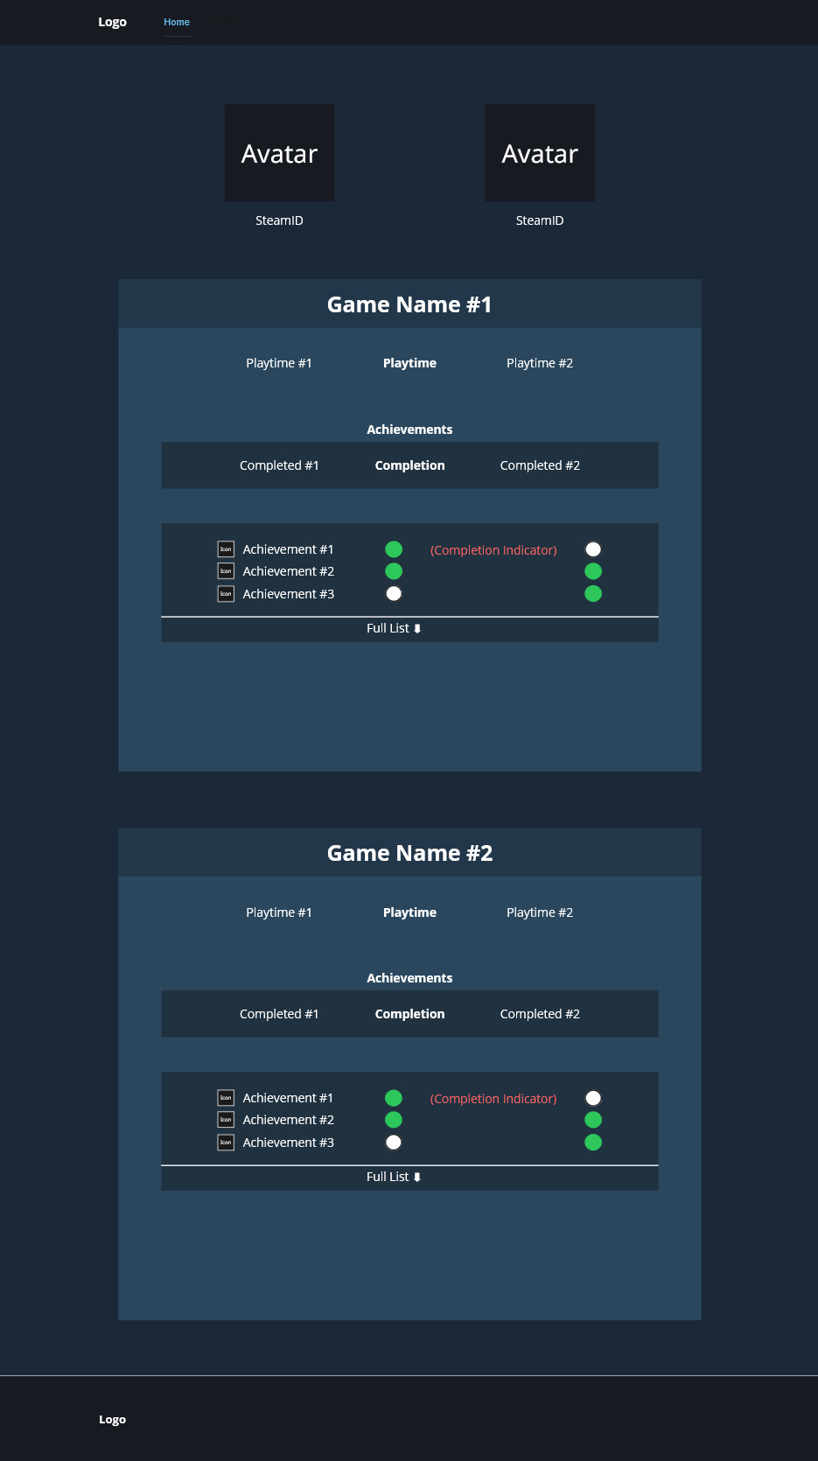
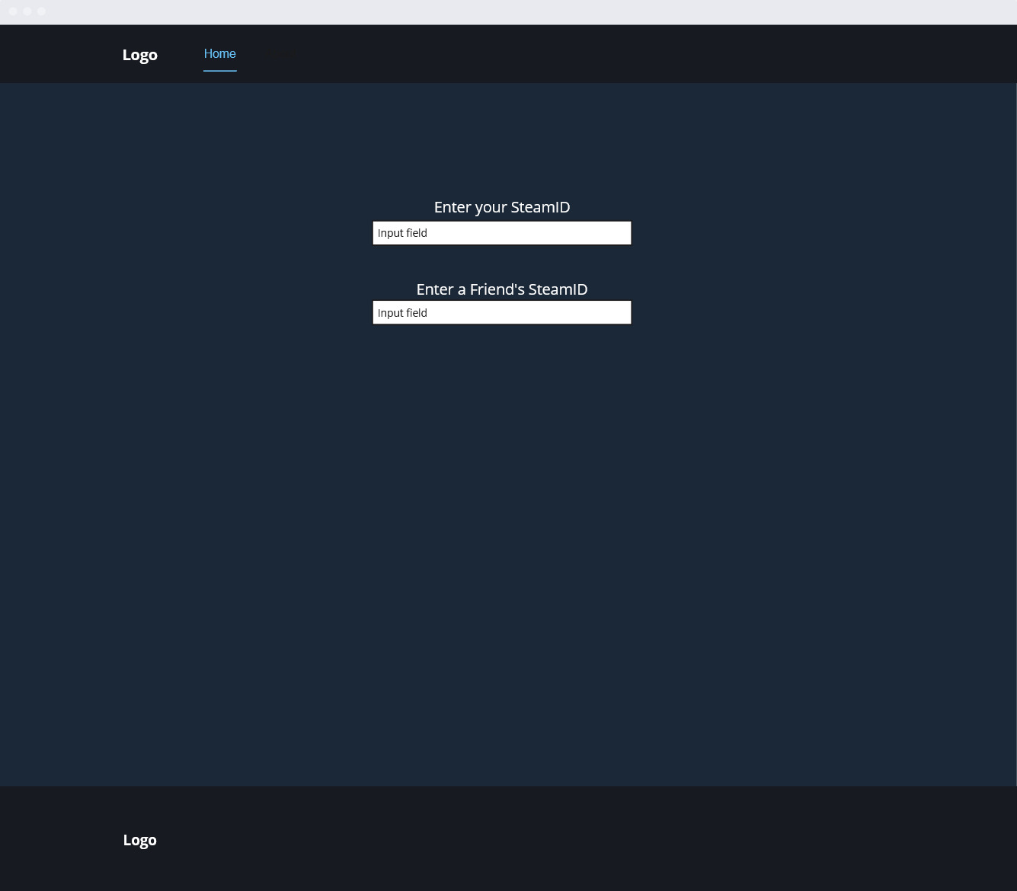
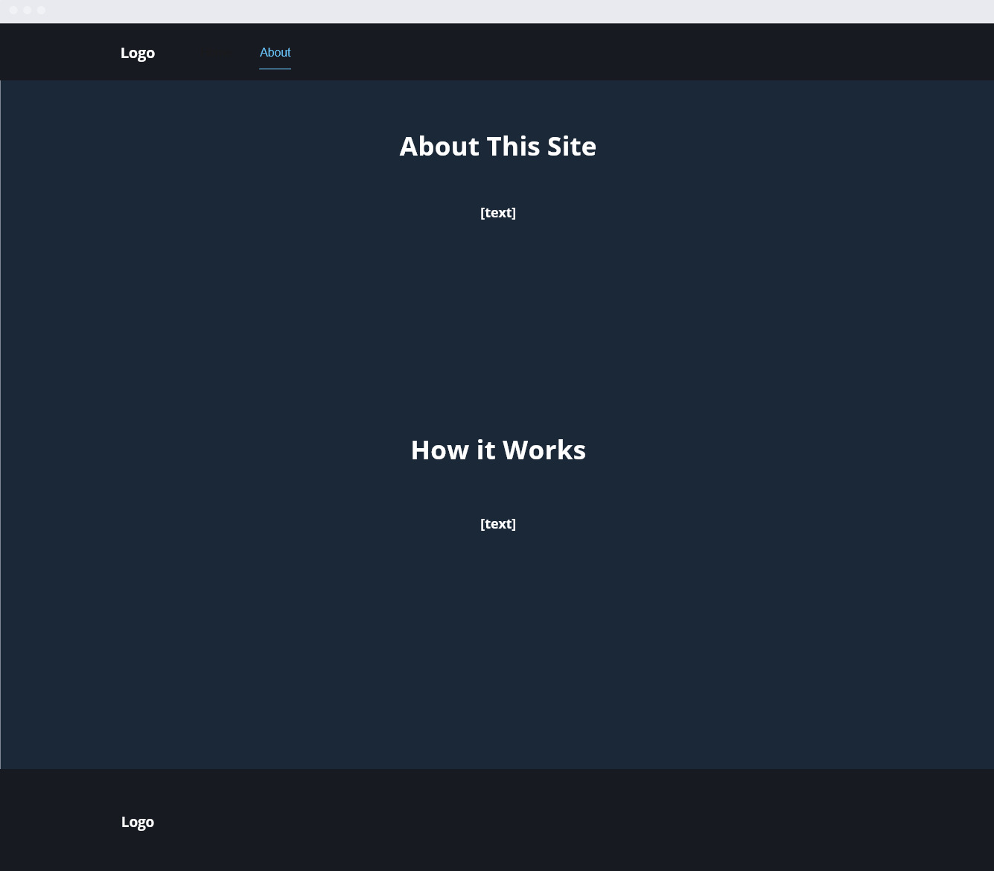
Prototypes
Comparison
Screen
Input Screen
About Page

Slide 9
Programming
APIs
  For API gathering we took a more “Object Oriented” approach
    All endpoints contained in their own function, which references “Fetch API”, and would do any necessary data cleaning
      Fetch API grabs and returns information from any endpoint.
    All functions would then be called from “FetchInformation” then fed into functions that populate the webpage
      Fetch information calls all API functions, then calls “CompareLibraries” and returns relevant information
        Compare Libraries accepts two libraries and returns a list of games each player has in common

Slide 10
Programming Challenges
Steam API
  Largest problem was inconsistent output
    Some games have empty or undefined names
    Games without achievements return empty arrays
    At one point a player id stopped working, reason was never found and the issue fixed itself
    Most of these issues were fixed by checking info validity
HTML
  Large number of elements needing to be filled with a large amount of information.
    Needs to be able to work with variable amounts of data, which means a large amount of programming required.
  Program needs to be able to function with empty or missing information, as a result program needs more scenarios programmed into checks.

Slide 11
What we Could’ve Done Next.
Improved efficiency
  Program takes a long time to run with large libraries
    Information we receive is sorted by appid, looping could be faster
Id searching
  Allow user to search id with steam name
    More intuitive
Compare against friends list
  Instead accept one id and search friends list
Hard code specific scenarios currently disregarded
  Some games return bad info and are disregarded, including some that could potentially be included. EX: Deadlock
Stats comparing
  Some games store specific stats, but because it’s so few we determined that they were too much of an edge case to be in scope.

